Slide 1



F
I
R
S
T
C
O
R
N
A
N
I
T
H
I
S
3
.
-
23
4
A free CD of this message will be available following the service
It will also be available for podcast later this week at calvaryokc.com

Slide 2
Chapter 2: Spiritual man vs. Natural man
A Spiritual man is a regenerate man whose mind is set on Christ
A Natural man is an unregenerate man
O
A
N
S
3.4-23
I
I
F
I
R
S
T
C
R
N
T
H

Slide 3
Chapter 3: Spiritual man vs. carnal man
A Spiritual man is a regenerate man whose mind is set on Christ
A Carnal man is a regenerate man whose mind is set on the flesh
O
A
N
S
3.4-23
I
I
F
I
R
S
T
C
R
N
T
H

Slide 4
Ministers: diakonos – one who serves others
O
A
N
S
3.4-23
I
I
F
I
R
S
T
C
R
N
T
H

Slide 5
Master builder: architektōn – literally, first craftsman
O
A
N
S
3.4-23
I
I
F
I
R
S
T
C
R
N
T
H

Slide 6
Four Separate Judgments:
1. Under the Abrahamic Covenant (Luke 16.19-31)
2. Believers after the cross (2 Cor. 5.10)
bēma Seat judgment
3. The Judgment of the Nations (Matt. 25:31-46)
Sheep and Goats judgment
O
A
N
S
3.4-23
I
I
F
I
R
S
T
C
R
N
T
H

Slide 7
Four Separate Judgments:
4. Great White Throne Judgment (Rev. 20.11-15)
O
A
N
S
3.4-23
I
I
F
I
R
S
T
C
R
N
T
H

Slide 8
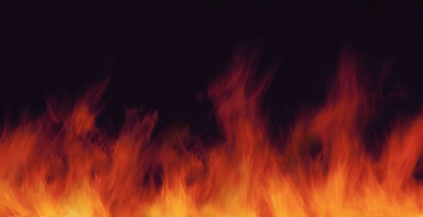
1. Under the Abrahamic Covenant (Luke 16.19-31)
Hades / Sheol
Abraham’s Bosom
Eph. 4.8-10
Place of Torment
1 Pet. 3.18-20
O
A
N
S
3.4-23
I
I
F
I
R
S
T
C
R
N
T
H

Slide 9
2. For believers after the Cross (2 Cor. 5:10)
For we must all appear before the judgment seat of Christ, that each one may receive the things done in the body, according to what he has done, whether good or bad.
bēma Seat judgment
O
A
N
S
3.4-23
I
I
F
I
R
S
T
C
R
N
T
H

Slide 10
2. For believers after the Cross (2 Cor. 5:10)
Not a judgment for sins, but determination of awarding or withholding crowns (rewards)
Rev. 4.10 – greater number of crowns – greater degree of fulfillment in heaven
O
A
N
S
3.4-23
I
I
F
I
R
S
T
C
R
N
T
H

Slide 11
3. The Judgment of the Nations (Matt. 25:31-46)
Also called “the Sheep and Goats judgment”
Presumably a judgment of the gentile nations on how they received the Jews during the Tribulation
O
A
N
S
3.4-23
I
I
F
I
R
S
T
C
R
N
T
H

Slide 12
3. The Judgment of the Nations (Matt. 25:31-46)
Sheep: Inasmuch as you did it to one of the least of these My brethren, you did it to Me.
Goats: Inasmuch as you did not do it to one of the least of these My brethren, you did not do it to Me.
O
A
N
S
3.4-23
I
I
F
I
R
S
T
C
R
N
T
H

Slide 13
4. The Great White Throne Judgment (Rev. 20:11-15)
At the end of the Millennium
All nonbelievers of all dispensations
All will be thrown into the lake of fire
O
A
N
S
3.4-23
I
I
F
I
R
S
T
C
R
N
T
H

Slide 14
Bēma Judgment
Nations Judgment
White throne Judgment
Church Age
Tribulation
Millennium
O
A
N
S
3.4-23
I
I
F
I
R
S
T
C
R
N
T
H

Slide 15
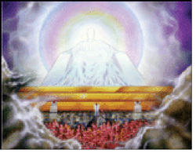
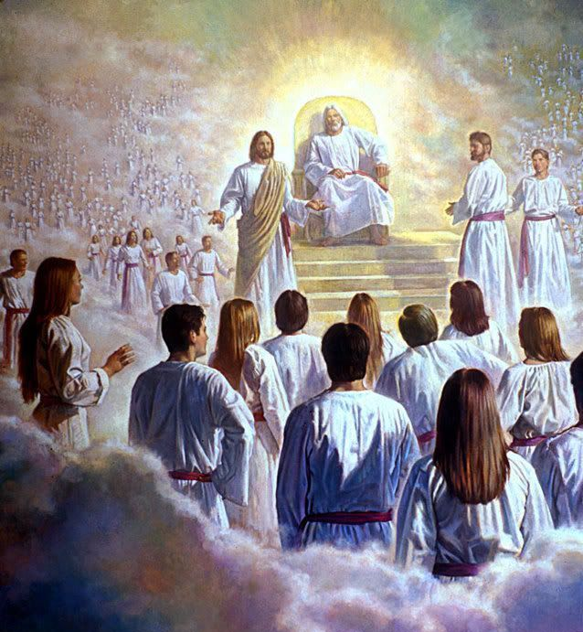
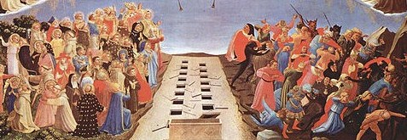
White Throne Judgment
Bēma Judgment
Nations Judgment
O
A
N
S
3.4-23
I
I
F
I
R
S
T
C
R
N
T
H

Slide 16
Defiles, destroy: same verb – phtheirō – usually translated corrupt
O
A
N
S
3.4-23
I
I
F
I
R
S
T
C
R
N
T
H

Slide 17
“God can't be omniscient and men have a free will at the same time.” (Metro Christian university professor)
O
A
N
S
3.4-23
I
I
F
I
R
S
T
C
R
N
T
H

